Slide 1
Employee Data Analysis using Excel
STUDENT NAME: SNEHA D
REGISTER NO: 312200202
NAN MUDHALVAN ID/ C2B22343D648B7E9F5442A6510611E61
DEPARTMENT: Commerce
COLLEGE : South Indian Vaniyar Education Trust College

Slide 2
PROJECT TITLE
Employee Performance Analysis using Excel

Slide 3


AGENDA
Problem Statement
Project Overview
End Users
Our Solution and Proposition
Dataset Description
Modelling Approach
Results and Discussion
Conclusion
3/21/2024 Annual Review

Slide 4

PROBLEM STATEMENT
1.Manual employee performance tracking is time-consuming, prone to errors, and lacks data-driven insights, making it challenging for organizations to make informed decisions
2.Current methods rely on subjective evaluations, leading to biases and inconsistent assessments.
3.The lack of real-time data and analytics hinders proactive decision-making and timely interventions.
4.Inefficient processes result in wasted resources, decreased productivity, and missed opportunities for growth and development .

Slide 5

PROJECT OVERVIEW
.
This project aims to develop an automated employee performance analysis tool using Excel, streamlining the process and providing actionable insights for data-driven decision-making.
1. The tool will enable HR professionals and managers to: Track employee performance metrics in real-time
2. Identify areas for improvement and development needs.
3. Make informed decisions about promotions, training, and resource allocation
4. Enhance employee engagement and retention through data-driven feedback and coaching.

Slide 6

WHO ARE THE END USERS?
Primary end users:
- HR Professionals: responsible for tracking employee performance, identifying development needs, and making informed decisions about talent management.
- Managers and Team Leaders: responsible for evaluating employee performance, providing feedback and coaching, and making decisions about promotions and resource allocation.
Secondary End Users:
- Employees: will have access to their own performance data, enabling them to track their progress, set goals, and seek feedback and development opportunities.
- Senior Leadership: will have access to aggregated performance data, enabling them to make strategic decisions about talent management, resource allocation, and organizational development .

Slide 7

OUR SOLUTION AND ITS VALUE PROPOSITION
Our Solution:
- An automated employee performance analysis tool built in Excel
- Integrates data from existing HR systems and performance reviews
- User-friendly dashboard for easy navigation and visualization
Value Proposition:
- Saves time and reduces manual effort in tracking and analyzing employee performance
- Enhances accuracy and consistency in performance evaluations
- Provides actionable insights for informed decision-making about talent management and development

Slide 8
Dataset Description
Data Sources:
- HR Information System (HRIS)
- Employee Engagement Surveys
- Training and Development Records
Data Elements:
- Employee demographics (name, ID, department, role)
- Performance metrics (ratings, reviews, feedback)
- Training and development data (courses taken, certifications earned)
Data Frequency:
- Quarterly performance reviews
- Bi-annual engagement surveys
- Ongoing training and development records.

Slide 9

THE "WOW" IN OUR SOLUTION
1. Interactive Dashboards:
- Real-time data visualization for instant insights
- Customizable views for tailored analysis
2. Predictive Analytics:
- Identifies high-risk employees for proactive intervention
- Forecasts future performance trends .
3.Actionable Insights:
- Data-driven recommendations for development and growth
-Enhances employee engagement and retention
4.Scalability:
- Easily adapts to growing employee base
. - Integrates with existing HR system.
3/21/2024 Annual Review
9

Slide 10
MODELLING
Methodology:
- Data preparation and cleansing
- Feature engineering and selection
Algorithms:
- Regression analysis for performance prediction
- Clustering for employee segmentation
Data Transformation:
- Handling missing values and outliers
- Normalization and scaling
Model Evaluation:
- Performance metrics (accuracy, precision, recall)
- Cross-validation and testing
Insights Generation:
- Identifying key drivers of performance
- Detecting trends and patterns
10

Slide 11
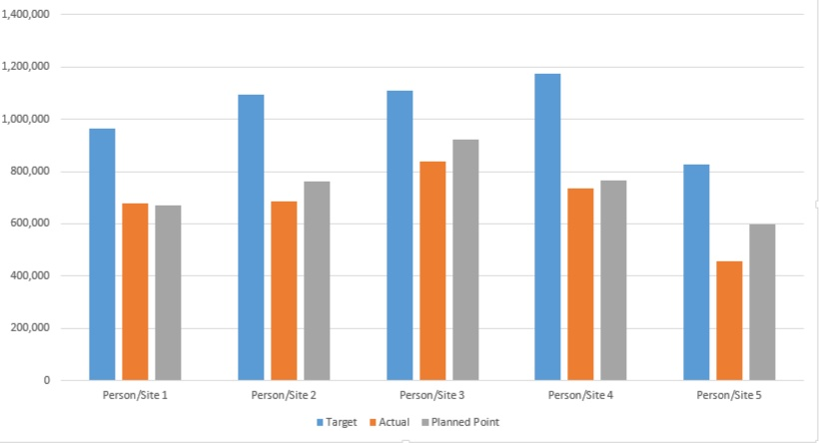
RESULTS
11

Slide 12
conclusion
Summary:
- Developed an automated employee performance analysis tool using Excel
- Improved accuracy and efficiency in performance tracking and prediction
Impact:
- Transformed talent management and development processes
- Enabled data-driven decision-making and strategic planning
- Positioned the organization for future growth and success
Recommendations:
- Continuously monitor and refine the tool for optimal performance
- Explore additional applications for predictive analytics in HR
Final Thoughts:
- The employee performance analysis tool has revolutionized our approach to talent management
- We are confident that it will continue to drive business success and growth.

